Slide 1
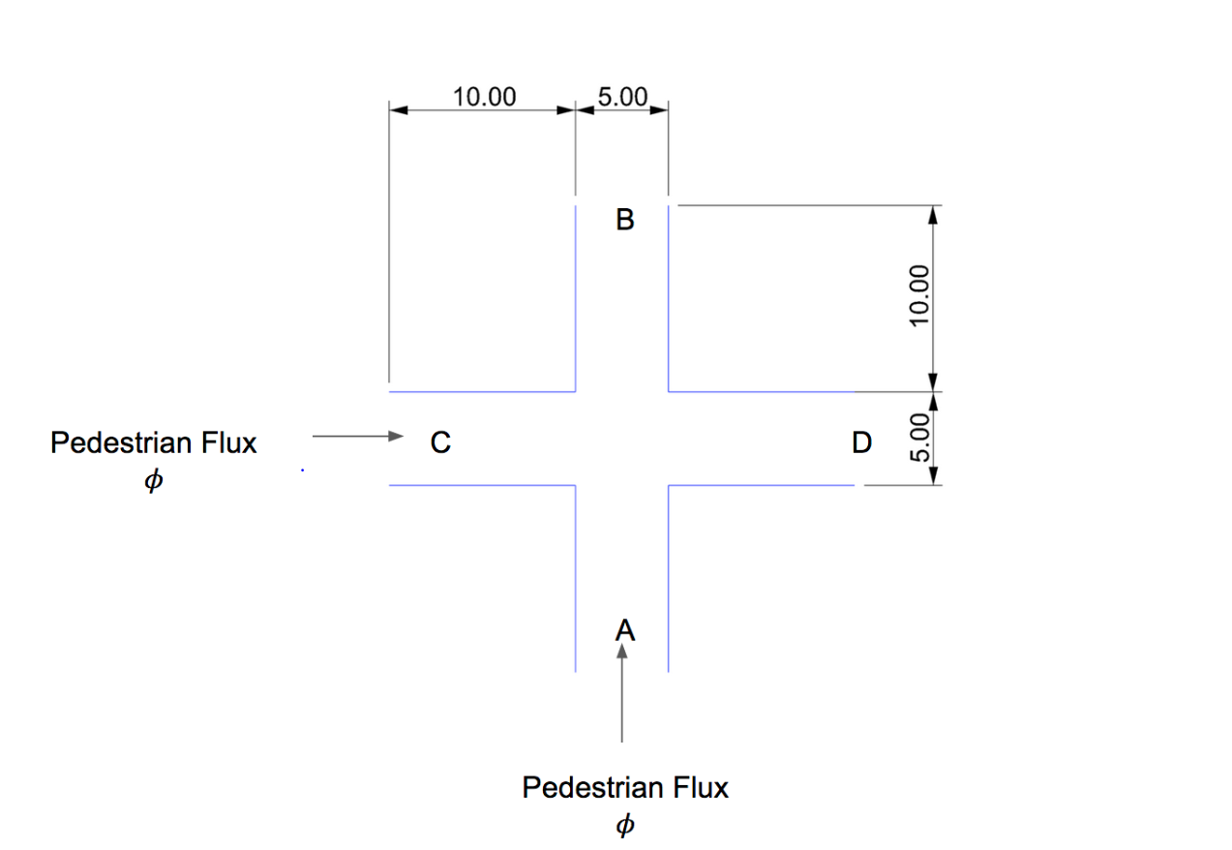
Pedestrian Flow Simulation
Arunaachalam Muralidharan
22.09.2020

Slide 2
Pedestrian Flow Simulation Overview: Results
CASE 1
ΦA = 0.2
ΦB = 0.2
CASE 2
ΦA = 0.5
ΦB = 0.5
CASE 3
ΦA = 1
ΦB = 1
CASE 4
ΦA = 2
ΦB = 2
Pedestrian Spawn Method: At points, A(0,13) and C(12,0)

Slide 3
Pedestrian Flow Simulation Overview: Results
CASE 2
ΦA = 0.5
ΦB = 0.5
CASE 1
ΦA = 0.2
ΦB = 0.2
Pedestrian Spawn Method: Random

Slide 4


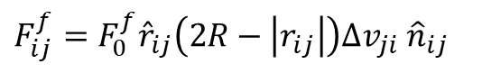
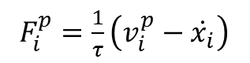
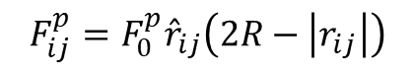
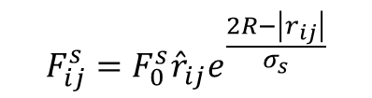
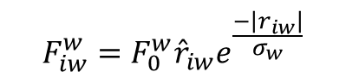
Pedestrian Flow Simulation Concept: Social Force Model - Modified
$${\dot{v}}_{i}=\sum{F_{i}}$$
Equations of Motion:
$${\dot{x}}_{i}=\left|v_{i}\right|max⁡\left(v_{i},v_{max⁡}\right)$$
ΦC = 2
ΦA = 1
Prefered Force Implementation
Wall Force Implementation
Repulsive Force Implementation
Various Pedestrian Flux
$$F_{iw}^{w}=F_{0}^{w}{\hat{r}}_{iw}e^{\frac{−\left|r_{iw}\right|}{σ_{w}}}$$
$$F_{ij}^{s}=F_{0}^{s}{\hat{r}}_{ij}e^{\frac{2R−\left|r_{ij}\right|}{σ_{s}}}$$
$$F_{ij}^{p}=F_{0}^{p}{\hat{r}}_{ij}\left(2R−\left|r_{ij}\right|\right)$$
$F_{i}^{p}=\frac{1}{τ}\left(v_{i}^{p}−\dot{x_{i}}\right)$
$F_{ij}^{f}=F_{0}^{f}{\hat{r}}_{ij}\left(2R−\left|r_{ij}\right|\right)∆v_{ji}$ ${\hat{n}}_{ij}$

Slide 5
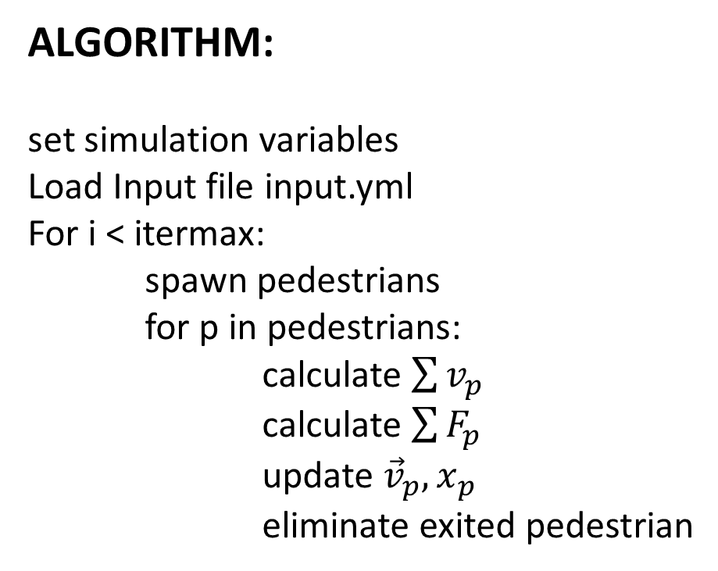
Pedestrian Flow Simulation Algorithm: Python Implementation
ALGORITHM:
set simulation variables
Load Input file input.yml
For i < itermax:
spawn pedestrians
for p in pedestrians:
calculate $\sum{v_{p}}$
calculate $\sum{F_{p}}$
update ${\vec{v}}_{p},x_{p}$
eliminate exited pedestrian
Class: FileReader
Class: World
Read input file
List – Pedestrian Class
Generate Pedestrian class
Calculation Forces
Eliminate Out-of-bounds
Update Pedestrian List
Class: Pedestrian
Characteristics
Update position
Update velocity

Slide 6
Pedestrian Flow Simulation Optimization and References
Possible Optimization:
Waiting algorithm is required in case of low pedestrian flux (refer slide 3)
Walls and Obstacles algorithm must be updated (now only works for crossing flows)
Accuracy of the simulation can be increased by implementing Probabilistic Pedestrian Spawn method
Parallel implementation for Force calculations and pedestrian velocity/position
References:
2013, Fredrik Johansson, Microscopic Modeling and Simulation of Pedestrian Traffic
2017, Hassan et al., A modified social force model for crowd dynamics
1995, Helbing et al., Social force model for pedestrian dynamics
2012, Mohcine Chraibi, Validated force-based modeling of pedestrian dynamics
2019, Chraibi et al, Generalized collision-free velocity model for pedestrian dynamics
GitHub: JupedSim, RexValkering

